Slide 1

IBM Project Presentation on IT System Log Analyzer
By
Group ID: G07
Dhruv Patel(20162171015)
Jay Sapra(20162171009)
Tanishk Patel(20162121020)
Institute of Computer Technology, Ganpat University
Date: 10th May 2024

Slide 2
Table of Contents
Introduction
Objectives
Expected Outcome
Tools & Technology
Methodology (Modules)
Flowchart
Implementation Details
Conclusion

Slide 3
Introduction
The Central Reserve Police Force (CRPF), integral to national security, faces challenges in efficiently monitoring IT systems across its dispersed units. The absence of a centralized log analysis system hinders swift identification and mitigation of potential cybersecurity threats. This project proposes an advanced IT System Log Analyzer to address this gap. By providing a centralized platform, the system empowers experts to systematically scrutinize logs from various CRPF locations, enhancing overall cybersecurity. The objective is to streamline monitoring, detect anomalies, and proactively respond to security incidents, fortifying CRPF's IT infrastructure against evolving threats. This project recognizes the need for a proactive and centralized approach, ensuring the resilience of CRPF's digital assets. Subsequent sections will detail the features and benefits of the proposed solution.

Slide 4
Objectives
The primary objective of the "IT System Log Analyzer" project is to establish a centralized system for comprehensive analysis of IT system logs across diverse locations where Central Reserve Police Force (CRPF) units, offices, and personnel are deployed. Currently lacking a centralized mechanism, the project aims to empower cybersecurity experts to scrutinize logs systematically, facilitating the timely detection and assessment of potential threats and breaches. By developing and implementing this centralized system, the project seeks to enhance CRPF's overall cybersecurity posture, enabling proactive responses to security incidents and fortifying the integrity of IT infrastructure deployed at various locations throughout the country.

Slide 5
Expected Outcome
The project aims to enable timely identification of anomalies, potential security threats, and breaches, allowing for proactive responses to security incidents. This, in turn, is expected to reduce the risk of data breaches, unauthorized access, and other cybersecurity vulnerabilities. The centralized log analysis system will facilitate a more streamlined and systematic monitoring process, ensuring that CRPF's IT infrastructure remains resilient in the face of evolving cybersecurity challenges.

Slide 6
Tools & Technology
Splunk
AWS EC2 instance
Ngrok

Slide 7
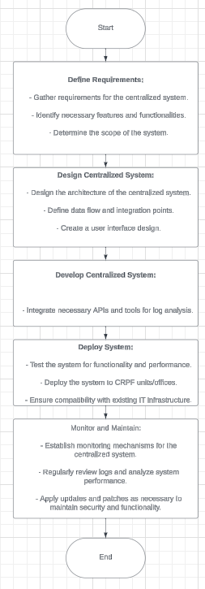
Flowchart
Flowchart

Slide 8
Implementation Details
Install Windows 10 for System Logs
We have to install windows 10 machine in VMware for the system logs.
Install Splunk in Main System
We have to install a Splunk in our main system to get log of the other machine.

Slide 9
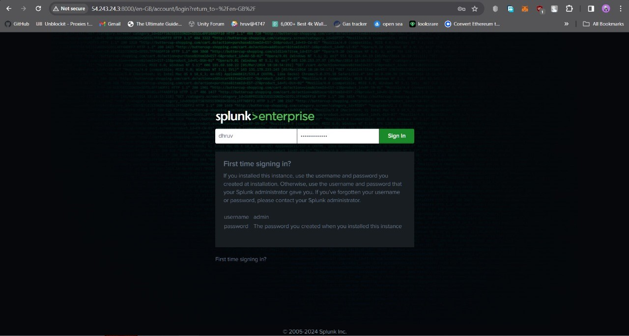
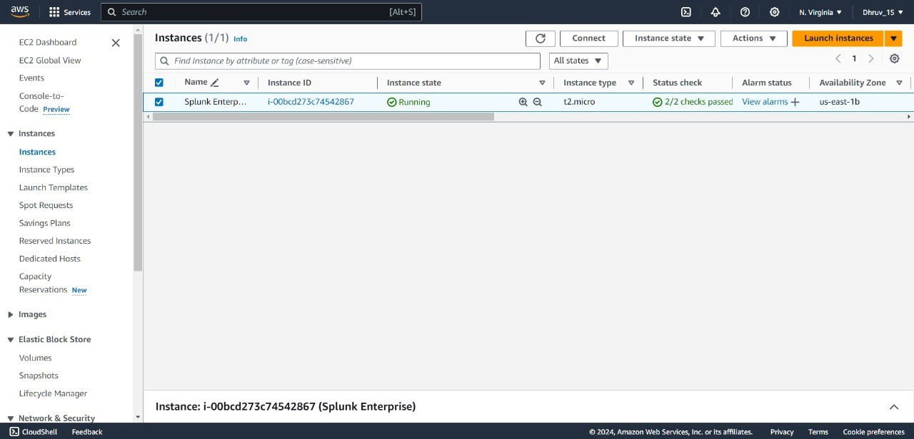

Slide 10
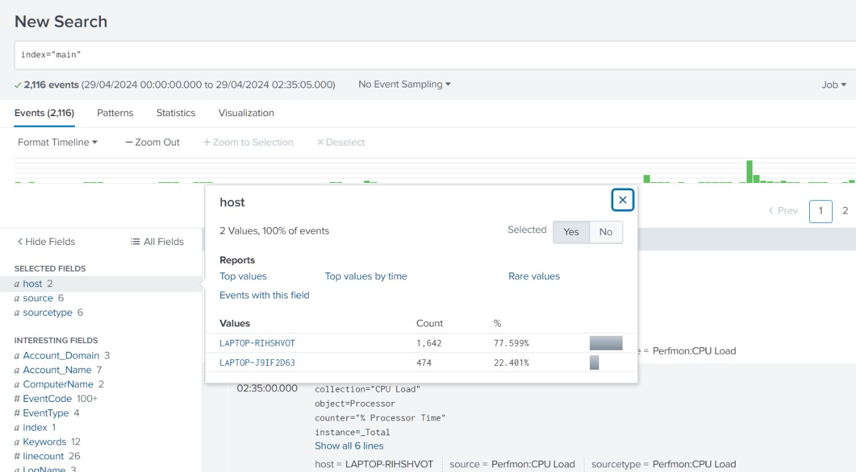

Slide 11
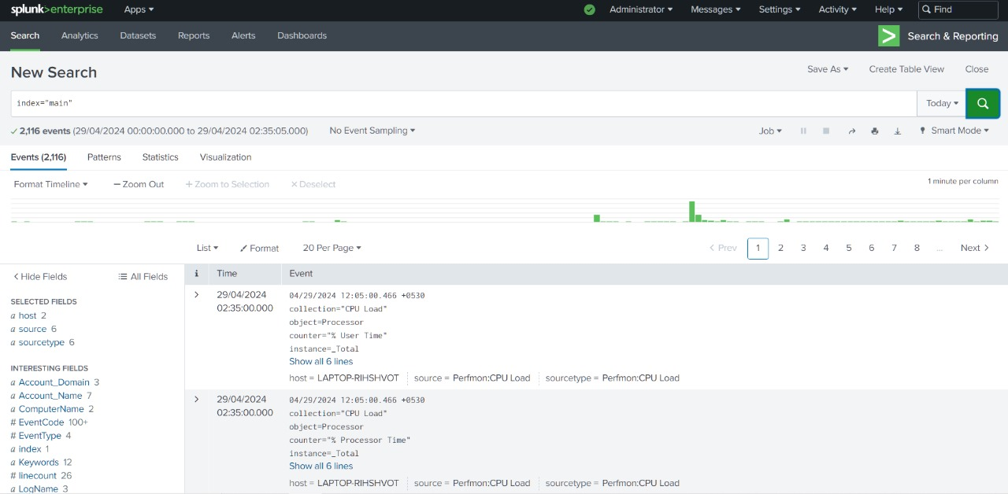

Slide 12
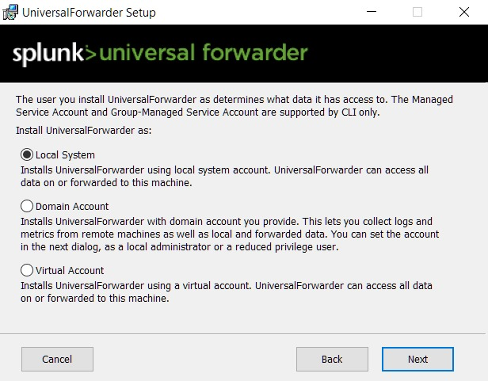
Setup Splunk Forwarder in VMware Machine
We have to setup a splunk forwarder in a VMware machine to forward logs of the VMware machine to main system. Whatever activity we will perform in VMware machine the data would be forward to my main system splunk.

Slide 13
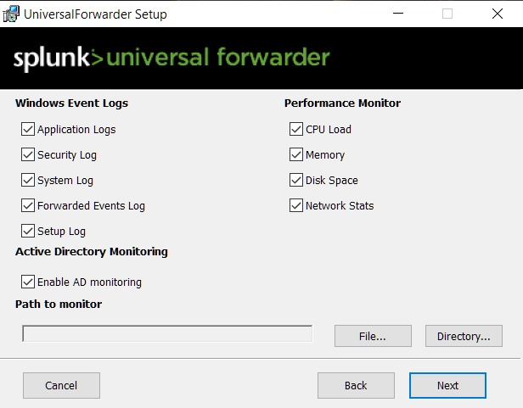

Slide 14
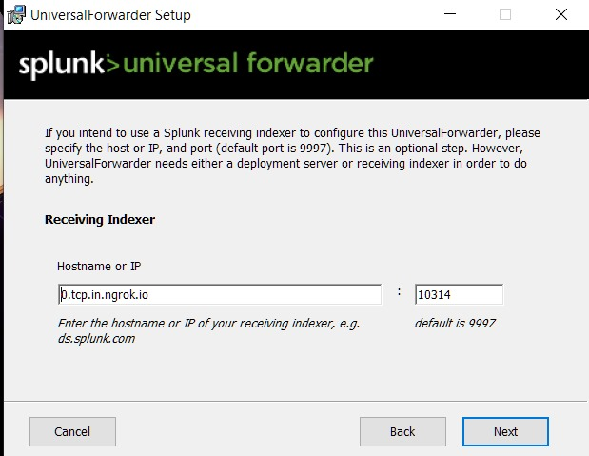

Slide 15
Create EC2 Instance and Integrate Splunk to EC2 Instance
Create EC2 instance to make centralized system. In centralized system we get all the logs from all the connected system at EC2 instance.

Slide 16
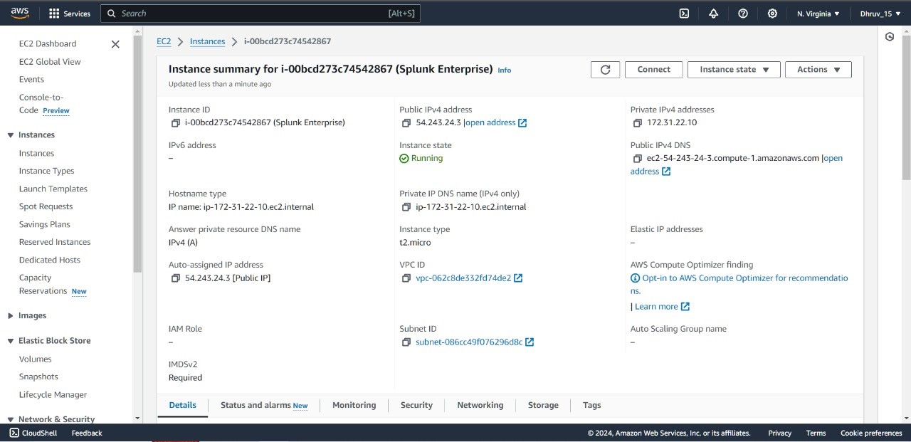

Slide 17
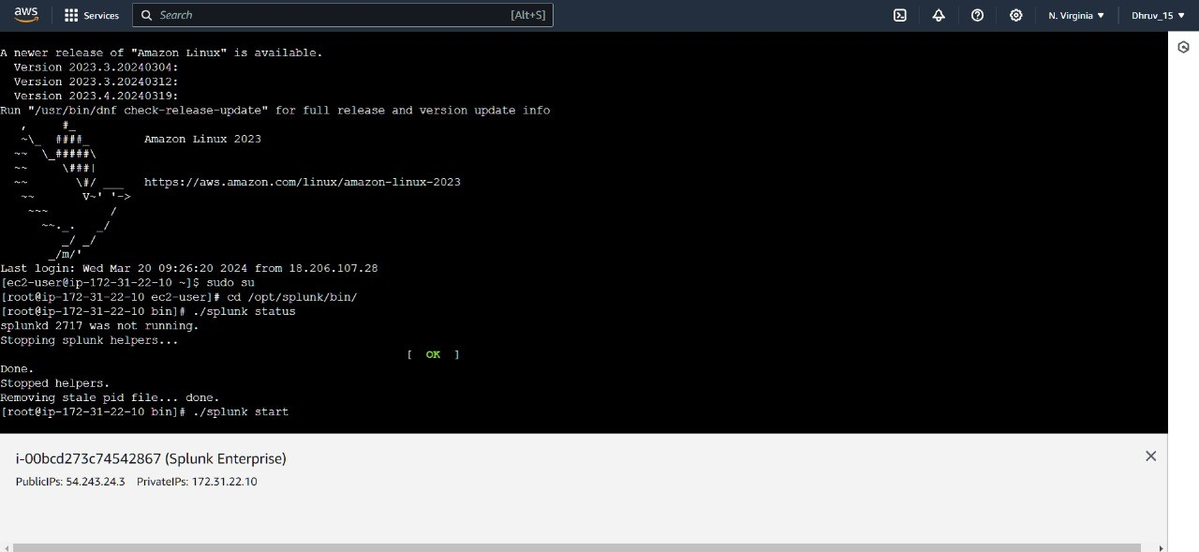

Slide 18
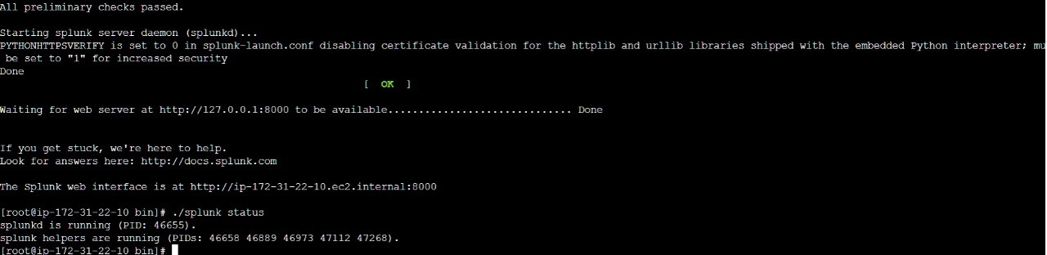

Slide 19
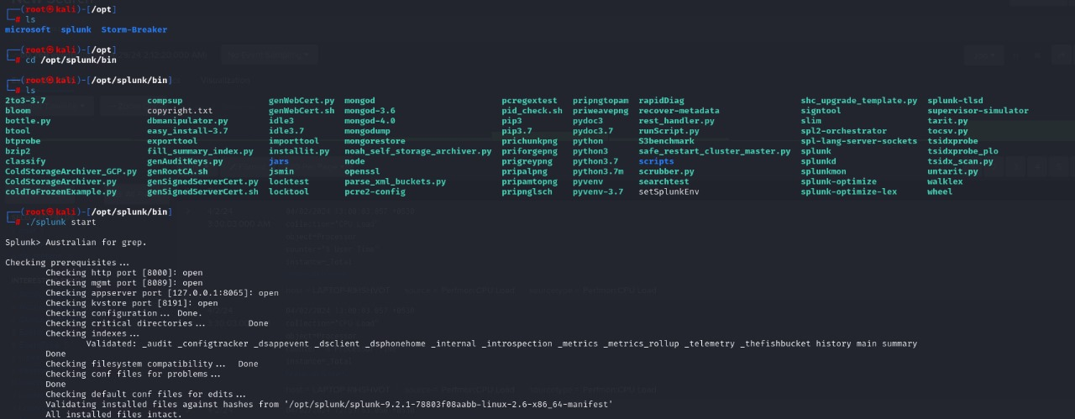
Setup Splunk Forwarder in VMware Machine
We got a storage problem in the AWS EC2 instance. That’s why we use Ngrok instead of AWS EC2.

Slide 20
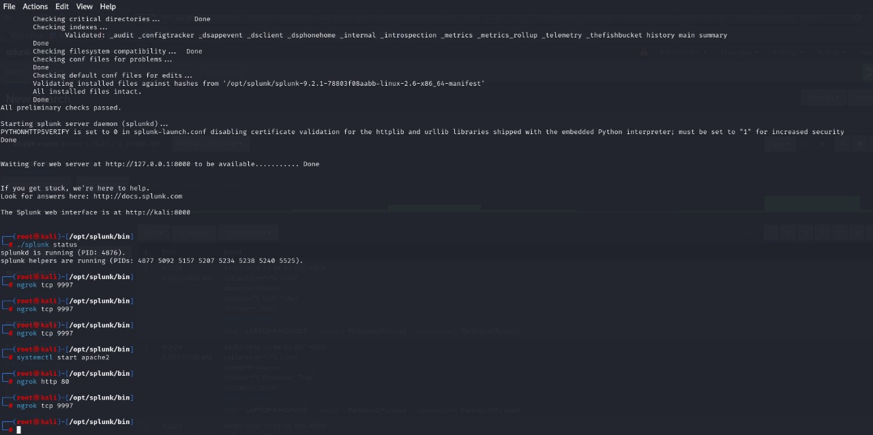

Slide 21
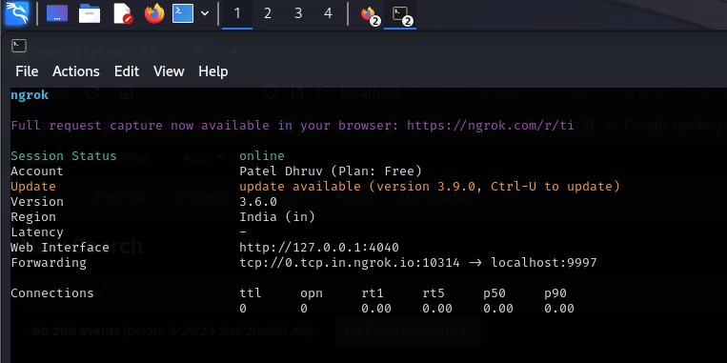

Slide 22
Conclusion
In conclusion, the "IT System Log Analyzer" project stands as a pivotal initiative in addressing the cybersecurity challenges faced by the Central Reserve Police Force (CRPF). The dispersed nature of CRPF units and offices across various locations necessitates a comprehensive solution to analyze IT system logs and identify potential threats and breaches. The absence of a centralized system has been recognized as a critical gap, and the proposed solution advocates for the development of a robust and centralized log analysis system.

Slide 23
Thank You !!

